Slide 1


Brightness Explosion Defect– R1 System
--- Marcos Magalhaes
MIS Customer Service Department – Mindray LATAM

Slide 2
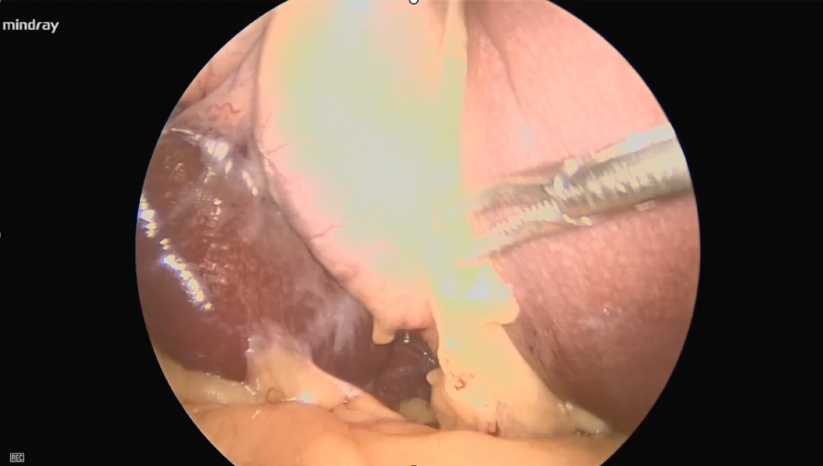
Background
At the beginning of the surgery, during the white balance procedure, the customer noticed a burst of brightness when the distal tip of the rigid endoscope was placed close to the gauze. Despite this, the telescope was inserted into the patient’s abdominal cavity, and the image below was observed. We initially replaced the telescope, light guide cable, and camera head, but the issue persisted. To allow the surgery to continue, we replaced only the processor, which resolved the problem—indicating that the processor has a malfunction that needs to be investigated.
During the Surgery (White Light)

Slide 3
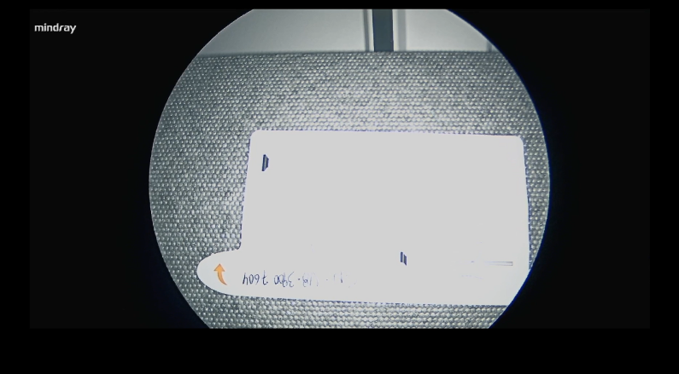
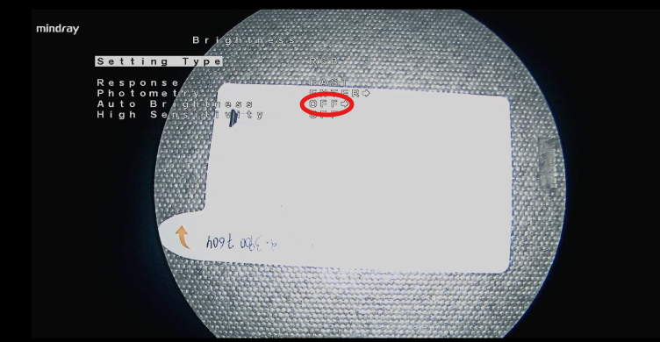
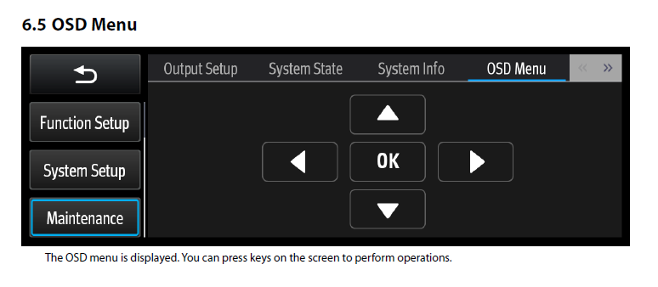
Crosscheck Verification
In this case, we recommend removing the equipment and sending it to the workshop for crosscheck and repair. Ideally, a second processor should be used for comparison during testing.The error occurs because the video processor does not keep the auto brightness adjustment function active. In the video below, when accessing the OSD menu (service menu), we can see that the function is deactivated. When activated, the issue does not occur, as the processor board’s algorithm automatically adjusts the brightness according to the distance from the patient's mucosa.

Slide 4
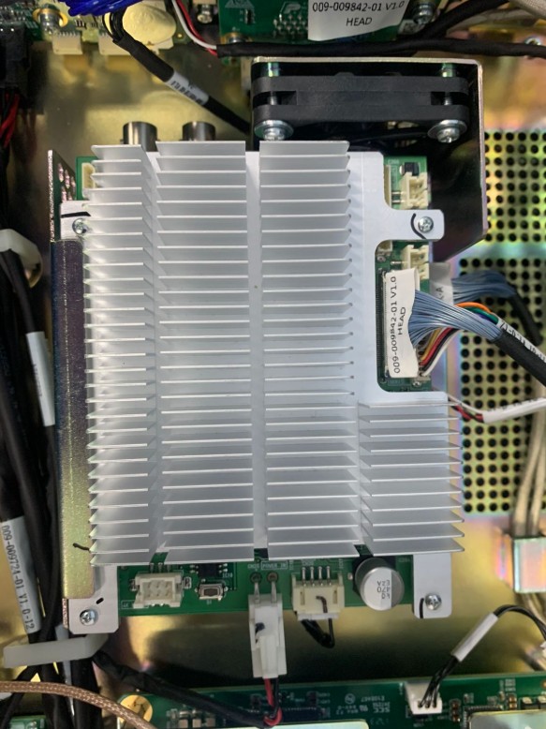
Crosscheck and Preliminary Verification
When activated, the function corrects the issue; however, certain settings in the OSD menu are not saved after the equipment is turned off. In a properly functioning processor, this feature remains permanently active.In this case, it is necessary to replace the video processing board. At the workshop, we were able to reproduce the error in another processor, confirming that replacing the video processing module will be effective in resolving this issue.
The item to be replaced is (PN 115-076660-00 CCU Assembly NIR FRU):
Note: CCU is responsible for image algorithm processing, parameter adjustment, and menu functions. It provides power and video signals for the 2K output board through CN33 and CN42.

Slide 5
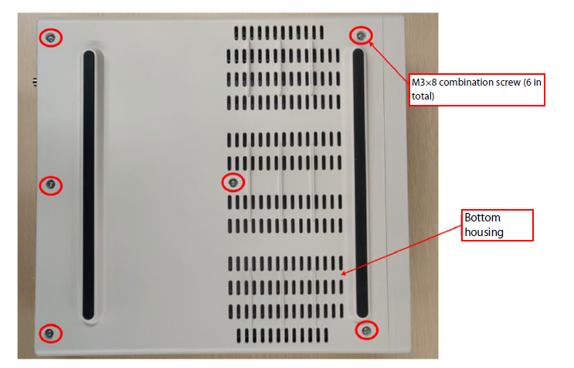
Component Replacement
To perform the crosscheck or replacement, follow the steps below.For reference, please refer to section “7.3 Disassembling the Host” to open the processor and replace the Video Processing Board.
1. Disassembling the Bottom Case Put the host upside down. Use a Phillips screwdriver to remove the six M3 combination screws, as shown in the figure. Bottom case and front panel components are tightened with fasteners. Lift the edges of the bottom case upwards to remove the bottom case.

Slide 6
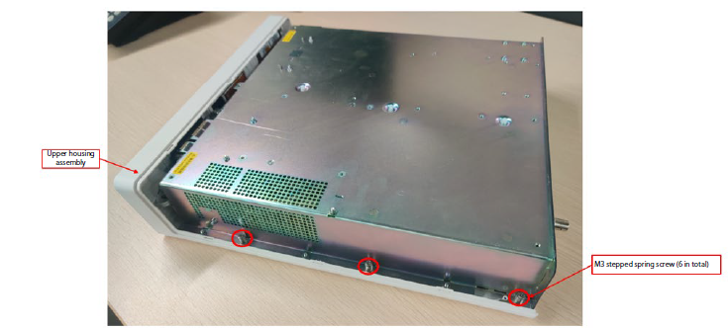
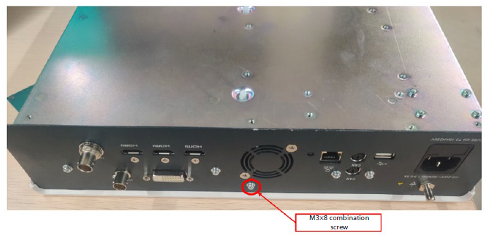
Component Replacement
2. Disassembling the Front Panel Assembly Place the host upside down. Use a Phillips screwdriver to remove six M3 stepped spring screws and washers, as shown in the figure. Then, remove three M3 combination screws that are used for fixing the shielding cover from one side. Remove one M3 combination screw from the rear panel. Remove the cables of the touchscreen, display screen, and power button and take down the upper housing assembly.

Slide 7
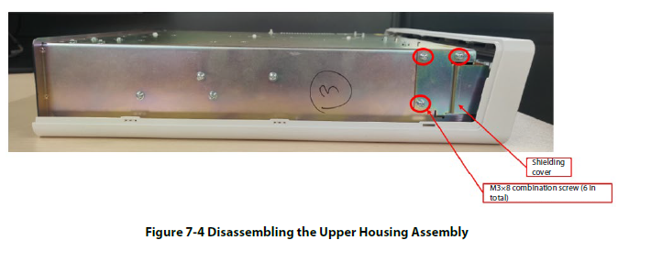
Component Replacement
2. Disassembling the Front Panel Assembly Place the host upside down. Use a Phillips screwdriver to remove six M3 stepped spring screws and washers, as shown in the figure. Then, remove three M3 combination screws that are used for fixing the shielding cover from one side. Remove one M3 combination screw from the rear panel. Remove the cables of the touchscreen, display screen, and power button and take down the upper housing assembly.
Caution: The flat cable lock is a lever and must be released by lifting it upwards. Use a thin screwdriver or tweezers to perform this disassembly. Ensure that the flat cable, the side connector, and the button connector are fully disconnected before separating the main block from the top cover. Make sure to follow these steps carefully to avoid damaging the cables.

Slide 8
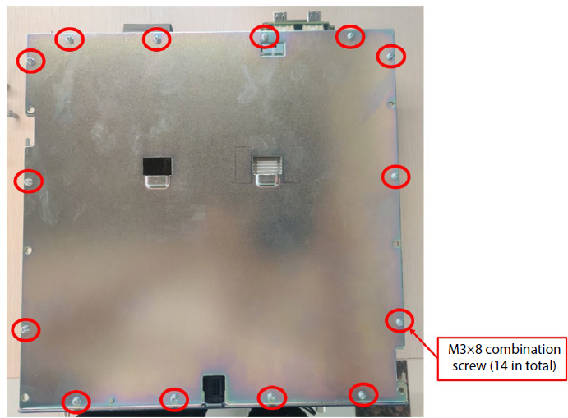
Component Replacement
3. Disassembling the Upper Cover of the Chassis Put the top of the chassis facing upward. Use a Phillips screwdriver to remove fourteen M3 combination screws, as shown in the figure below, and take down the upper cover of the chassis.

Slide 9
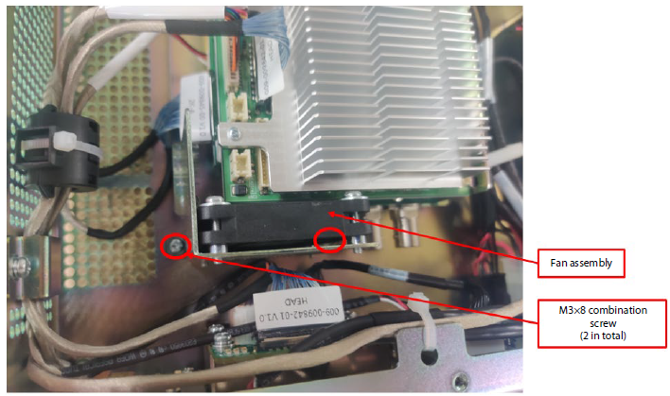
Component Replacement
4. Disassembling the CCU Assembly As shown in the figure, remove all the connected cables, then use a Phillips screwdriver to remove two M3 combination screws, and take down the fan assembly. Use the Phillips screwdriver to remove four M3 combination screws and take down the CCU assembly.

Slide 10
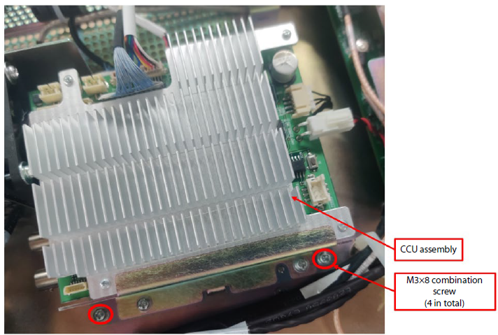
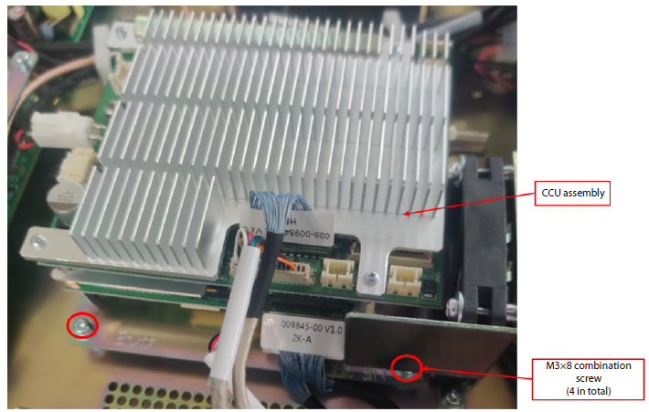
Component Replacement
4. Disassembling the CCU Assembly As shown in the figure, remove all the connected cables, then use a Phillips screwdriver to remove two M3 combination screws, and take down the fan assembly. Use the Phillips screwdriver to remove four M3 combination screws and take down the CCU assembly.

Slide 11
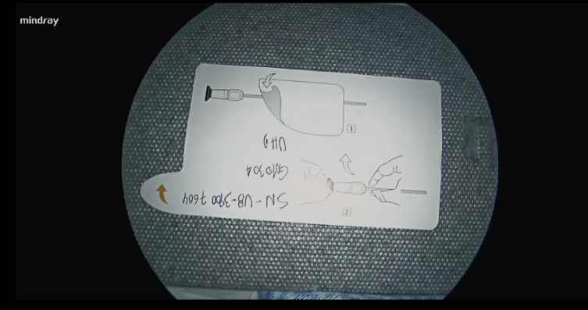
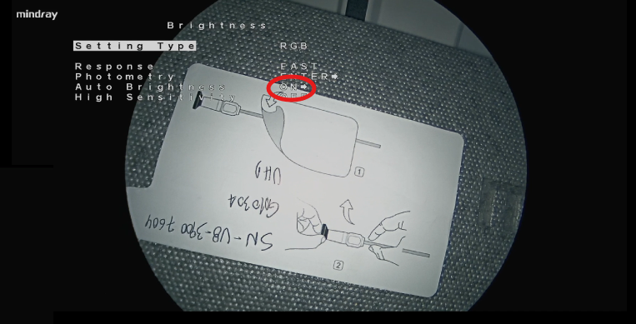
Verificação após a troca
After installing the video processing board, carefully connect the LCD and power on the equipment.
Use a sheet of paper with printed text, as shown in the video below, to perform the image test.It is also possible to verify—as demonstrated in the video—whether the function is natively active in the OSD menu, which confirms that the issue has been resolved.Once confirmed, proceed with the complete reassembly of the equipment.

Slide 12
Thank you！
Notes:
That’s all.

